Slide 1
CSCI317 – Database Performance Tuning
Materialized View – Selection Algorithm
24 January 2019

Slide 2
Materialized view …1/3
Materialized view:
A view that is physically stored in a database
Materialized views enhance query performance by pre-calculating costly operations such as joins and aggregation and storing the results in the database.
Materialized view improve query performance at the expense of storage space.

Slide 3
Materialized view …2/3
A typical problem of materialized views is updating because all modifications to the underlying base tables must be propagated into the view.
To minimized updating cost, incremental view maintenance is used, that is, updated view is computed (done) from changes and not the entire relation.

Slide 4
Materialized view …3/3
Selection of materialized views is important.
The goal is to select an appropriate set of views that minimizes the total query response time and the cost of maintaining the selected views, given a limited amount of resources such as storage space or materialization time.

Slide 5
View Selection Algorithm
Greedy algorithm by Harinarayan et al. (1996)
Given a cube lattice, finds the best set of views to materialize under a certain criteria.
It uses a lattice that takes into account two kinds of dependencies between nodes:
Attributes inclusion: {ProductKey} INCLUDED-IN {ProductKey, CustomerKey}
Hierarchy dependency: Given a hierarchy Month → Year, an aggregation over Month can be used to compute the aggregation over Year.

Slide 6
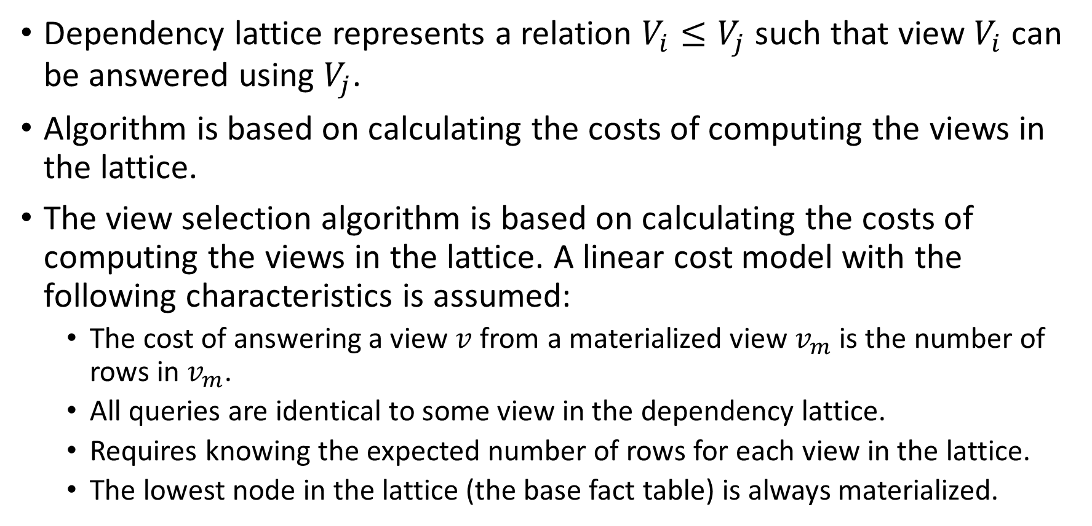
View Selection Algorithm
Dependency lattice represents a relation $V_{i}≤V_{j}$ such that view $V_{i}$ can be answered using $V_{j}$.
Algorithm is based on calculating the costs of computing the views in the lattice.
The view selection algorithm is based on calculating the costs of computing the views in the lattice. A linear cost model with the following characteristics is assumed:
The cost of answering a view $v$ from a materialized view $v_{m}$ is the number of rows in $v_{m}$.
All queries are identical to some view in the dependency lattice.
Requires knowing the expected number of rows for each view in the lattice.
The lowest node in the lattice (the base fact table) is always materialized.

Slide 7
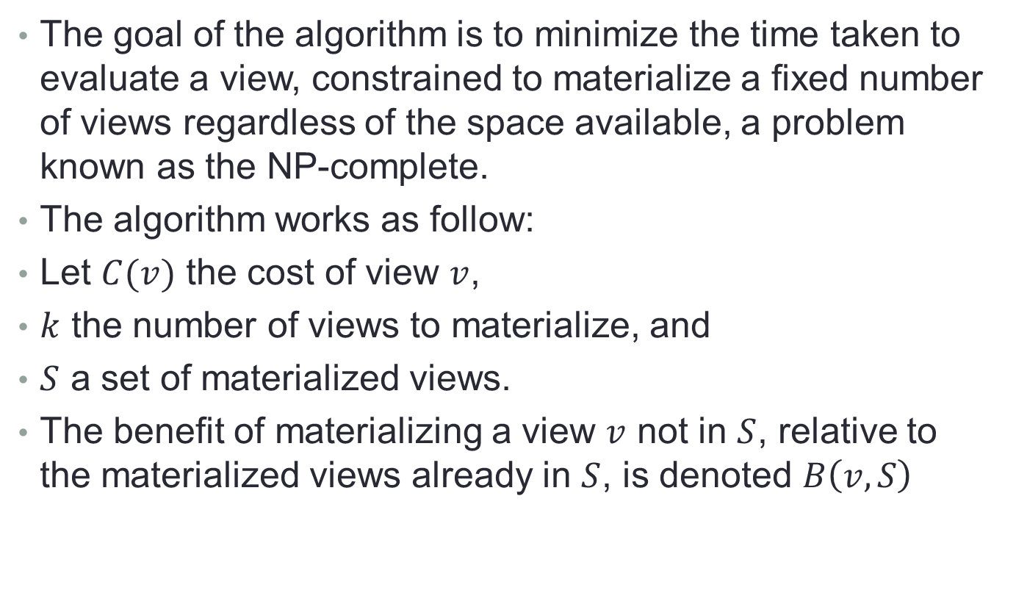
View Selection Algorithm
The goal of the algorithm is to minimize the time taken to evaluate a view, constrained to materialize a fixed number of views regardless of the space available, a problem known as the NP-complete.
The algorithm works as follow:
Let $C(v)$ the cost of view $v$,
$k$ the number of views to materialize, and
$S$ a set of materialized views.
The benefit of materializing a view $v$ not in $S$, relative to the materialized views already in $S$, is denoted $B\left(v,S\right)$

Slide 8
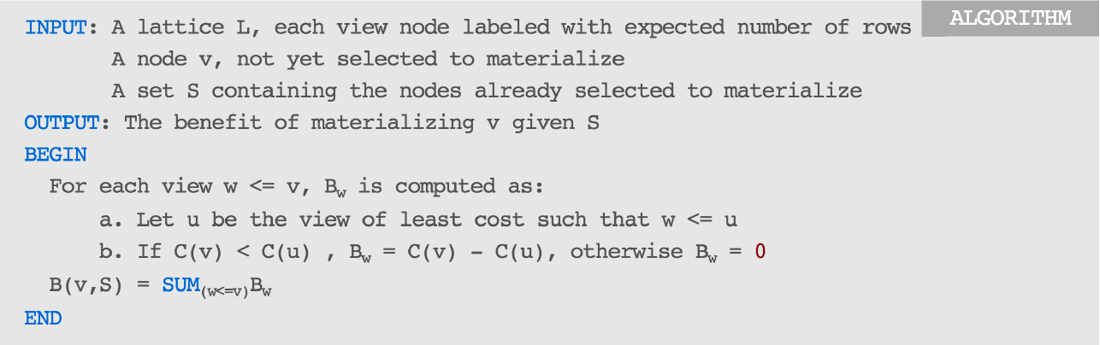
View Selection Algorithm

Slide 9
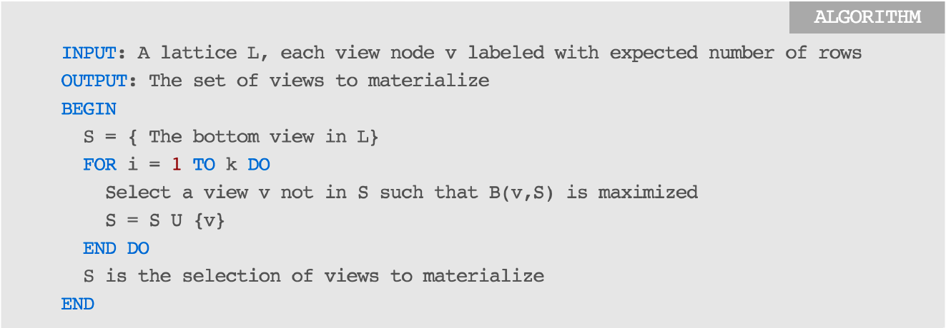
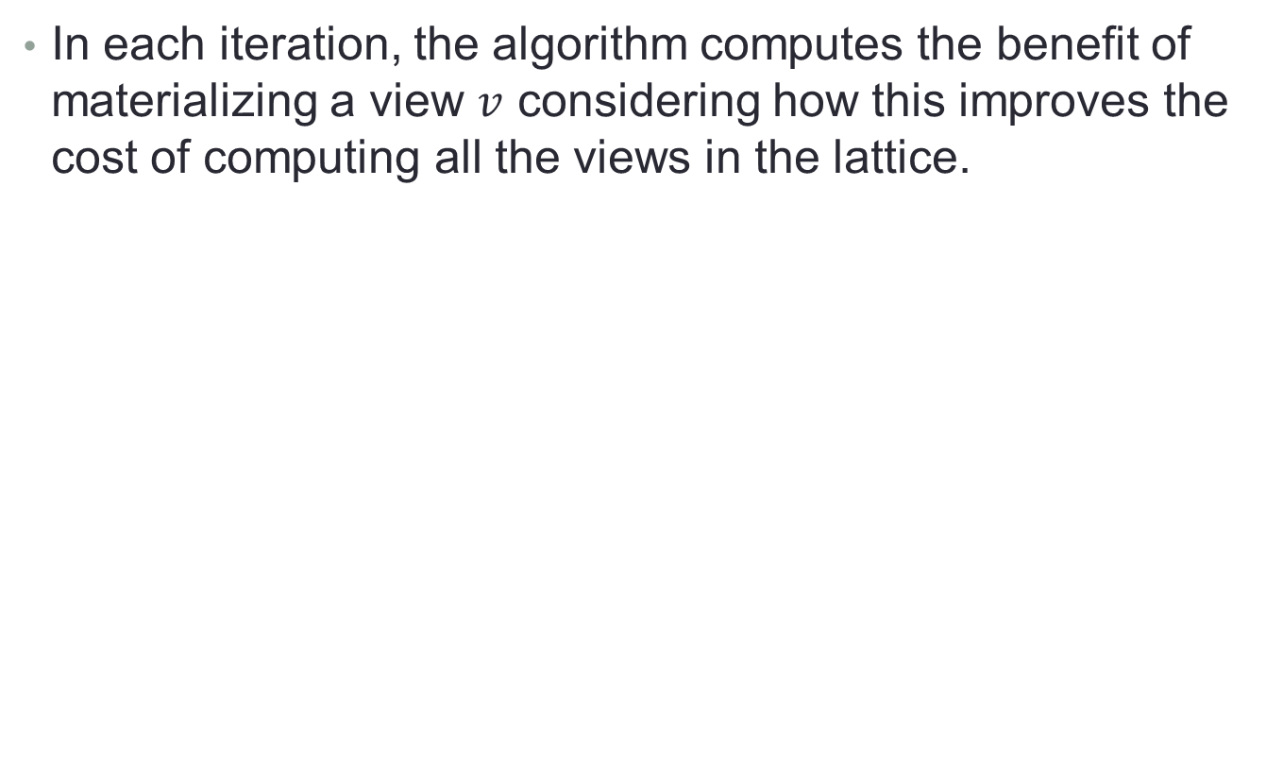
View Selection Algorithm
In each iteration, the algorithm computes the benefit of materializing a view $v$ considering how this improves the cost of computing all the views in the lattice.

Slide 10
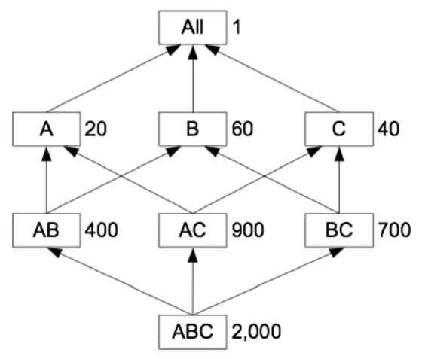
View Selection Algorithm
For example, based on the dependency lattice shown below, the bottom view (ABC) is already materialized, find another three views to materialize.
Next to each node, the cost of the view the node represents is indicated.
Dependency lattice, with the estimated number of tuples in each node (view)

Slide 11
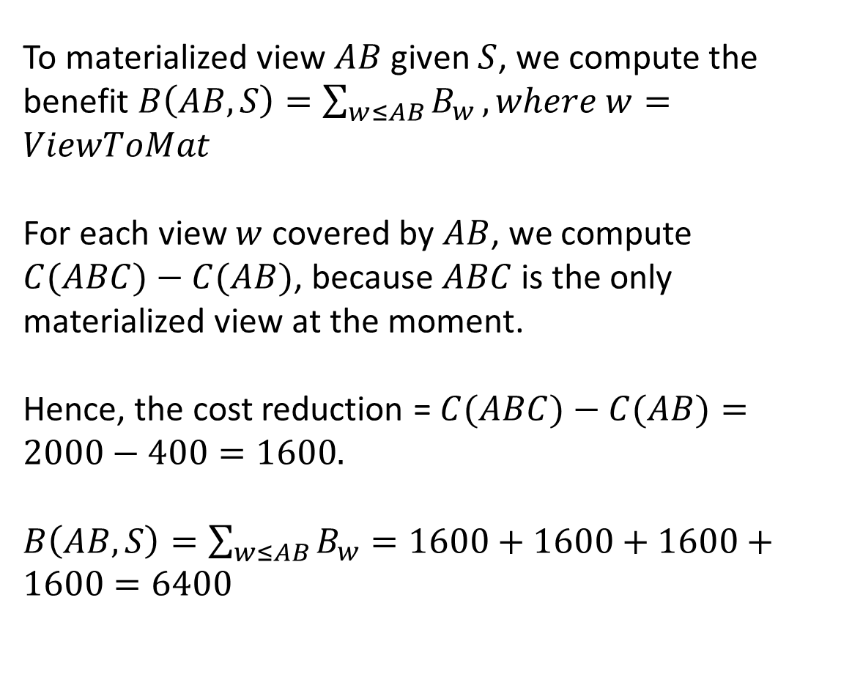
S = { | ABC | }
ViewToMat = w { | AB, | AC, | BC, | A, | B, | C, | All | }
CostReduction = | - | - | - | - | - | - | -
To materialized view $AB$ given $S$, we compute the benefit $B\left(AB,S\right)=\sum_{w≤AB}{B_{w}}, where w=ViewToMat$
For each view $w$ covered by $AB$, we compute $C(ABC)−C(AB)$, because $ABC$ is the only materialized view at the moment.
Hence, the cost reduction = $C(ABC)−C(AB)=2000−400=1600.$
$B\left(AB,S\right)=\sum_{w≤AB}{B_{w}}=1600+1600+1600+1600=6400$

Slide 12
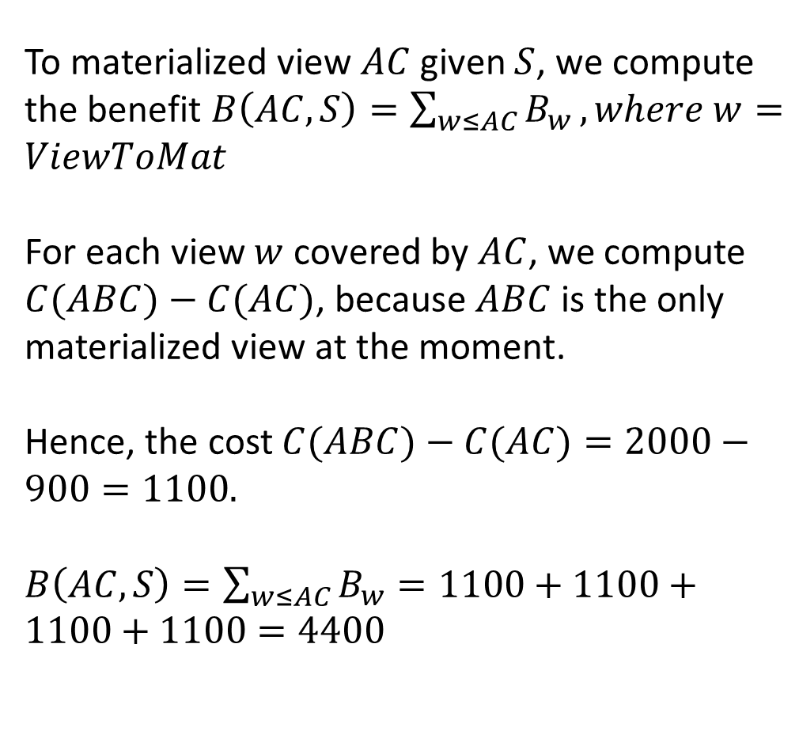
S = { | ABC | }
ViewToMat = w { | AB, | AC, | BC, | A, | B, | C, | All | }
CostReduction = | 6400 | - | - | - | - | - | -
To materialized view $AC$ given $S$, we compute the benefit $B\left(AC,S\right)=\sum_{w≤AC}{B_{w}}, where w=ViewToMat$
For each view $w$ covered by $AC$, we compute $C(ABC)−C(AC)$, because $ABC$ is the only materialized view at the moment.
Hence, the cost $C(ABC)−C(AC)=2000−900=1100.$
$B\left(AC,S\right)=\sum_{w≤AC}{B_{w}}=1100+1100+1100+1100=4400$

Slide 13
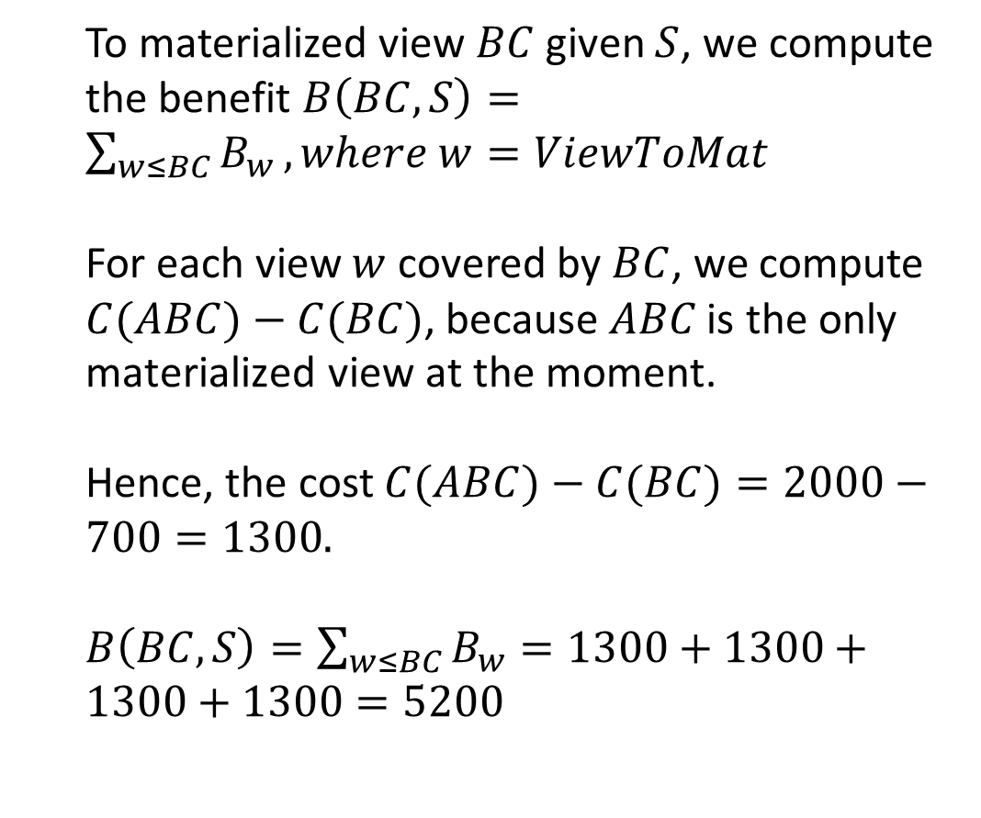
S = { | ABC | }
ViewToMat = w { | AB, | AC, | BC, | A, | B, | C, | All | }
CostReduction = | 6400 | 4400 | - | - | - | - | -
To materialized view $BC$ given $S$, we compute the benefit $B\left(BC,S\right)=\sum_{w≤BC}{B_{w}}, where w=ViewToMat$
For each view $w$ covered by $BC$, we compute $C(ABC)−C(BC)\text{, }\text{because} ABC \text{is} \text{the} \text{only} \text{materialized} \text{view} \text{at} \text{the} \text{moment}\text{.}$
Hence, the cost $C(ABC)−C(BC)=2000−700=1300.$
$B\left(BC,S\right)=\sum_{w≤BC}{B_{w}}=1300+1300+1300+1300=5200$

Slide 14
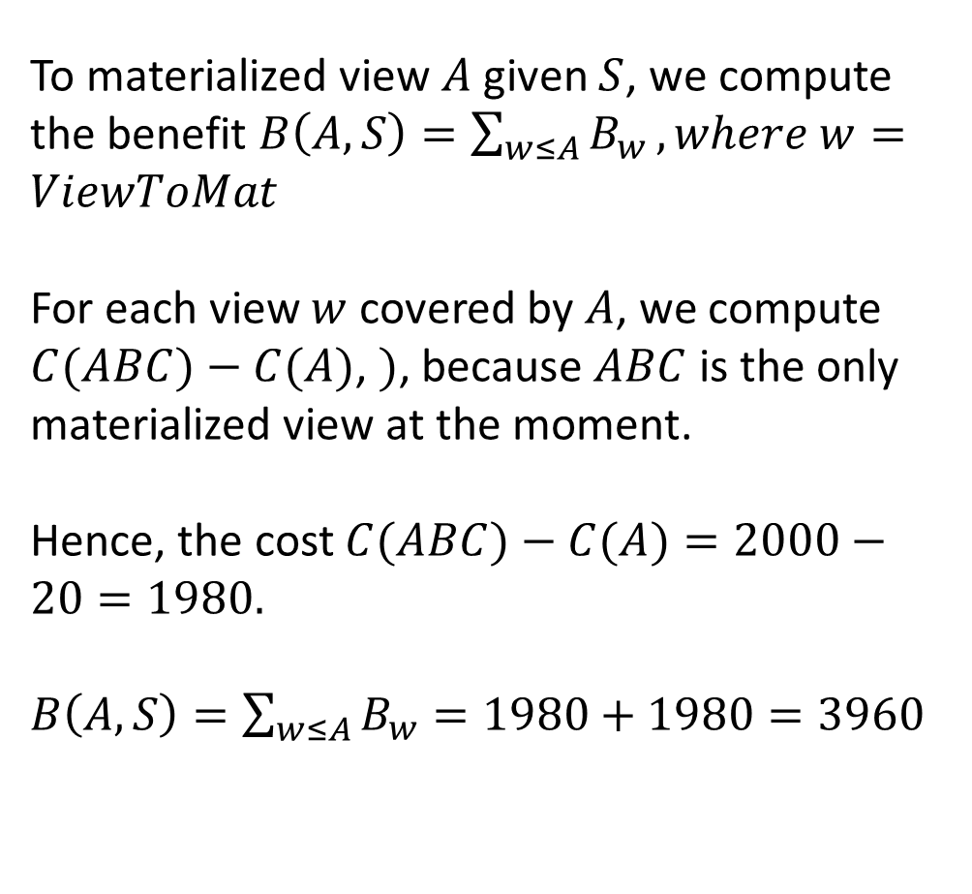
S = { | ABC | }
ViewToMat = w { | AB, | AC, | BC, | A, | B, | C, | All | }
CostReduction = | 6400 | 4400 | 5200 | - | - | - | -
To materialized view $A$ given $S$, we compute the benefit $B\left(A,S\right)=\sum_{w≤A}{B_{w}}, where w=ViewToMat$
For each view $w$ covered by $A$, we compute $C(ABC)−C(A)$, $)$, because $ABC$ is the only materialized view at the moment.
Hence, the cost $C(ABC)−C(A)=2000−20=1980.$
$B\left(A,S\right)=\sum_{w≤A}{B_{w}}=1980+1980=3960$

Slide 15
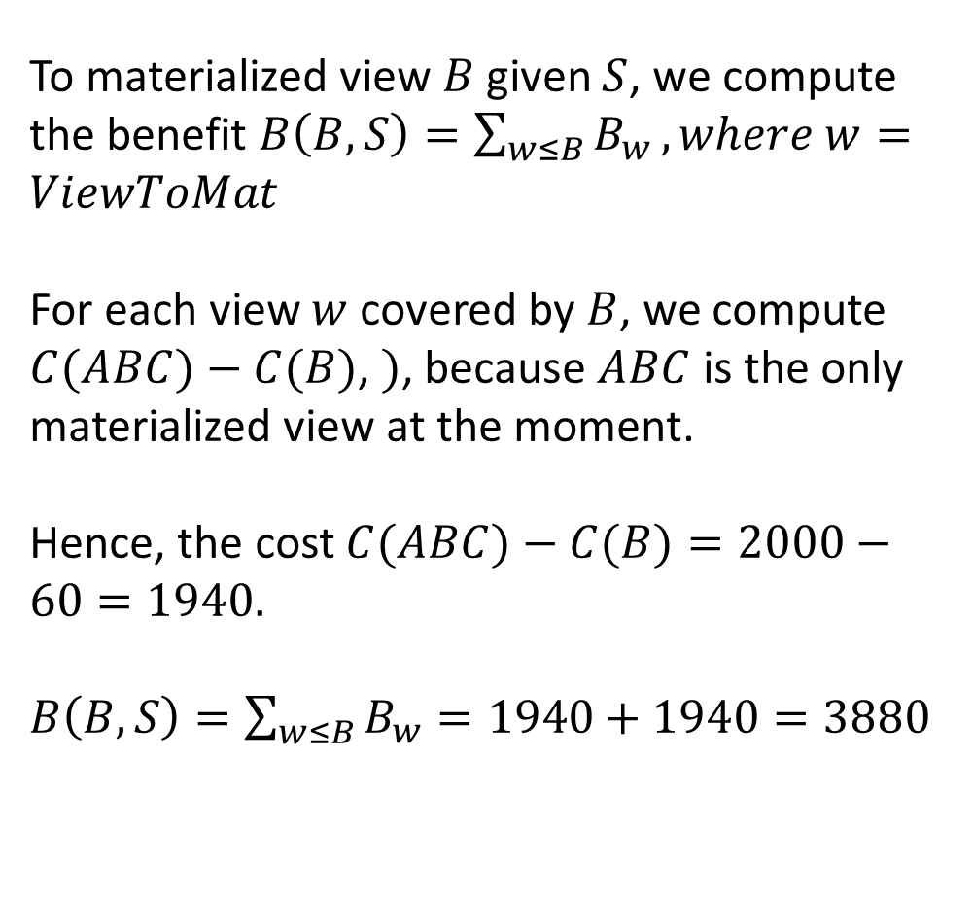
S = { | ABC | }
ViewToMat = w { | AB, | AC, | BC, | A, | B, | C, | All | }
CostReduction = | 6400 | 4400 | 5200 | 3960 | - | - | -
To materialized view $B$ given $S$, we compute the benefit $B\left(B,S\right)=\sum_{w≤B}{B_{w}}, where w=ViewToMat$
For each view $w$ covered by $B$, we compute $C(ABC)−C(B)$, $)$, because $ABC$ is the only materialized view at the moment.
Hence, the cost $C(ABC)−C(B)=2000−60=1940.$
$B\left(B,S\right)=\sum_{w≤B}{B_{w}}=1940+1940=3880$

Slide 16
S = { | ABC | }
ViewToMat = w { | AB, | AC, | BC, | A, | B, | C, | All | }
CostReduction = | 6400 | 4400 | 5200 | 3960 | 3880 | 3920 | 1999
Similar to all previous calculation, the cost reduction to materialized views C and All can be computed and they are 3920 and 1999 respectively.
From the cost reduction obtained, it is noted that 6400 units is the most benefit can be obtained if view AB is materialized. Hence according to the greedy algorithm, the view AB will be materialized.

Slide 17
Second iteration

Slide 18
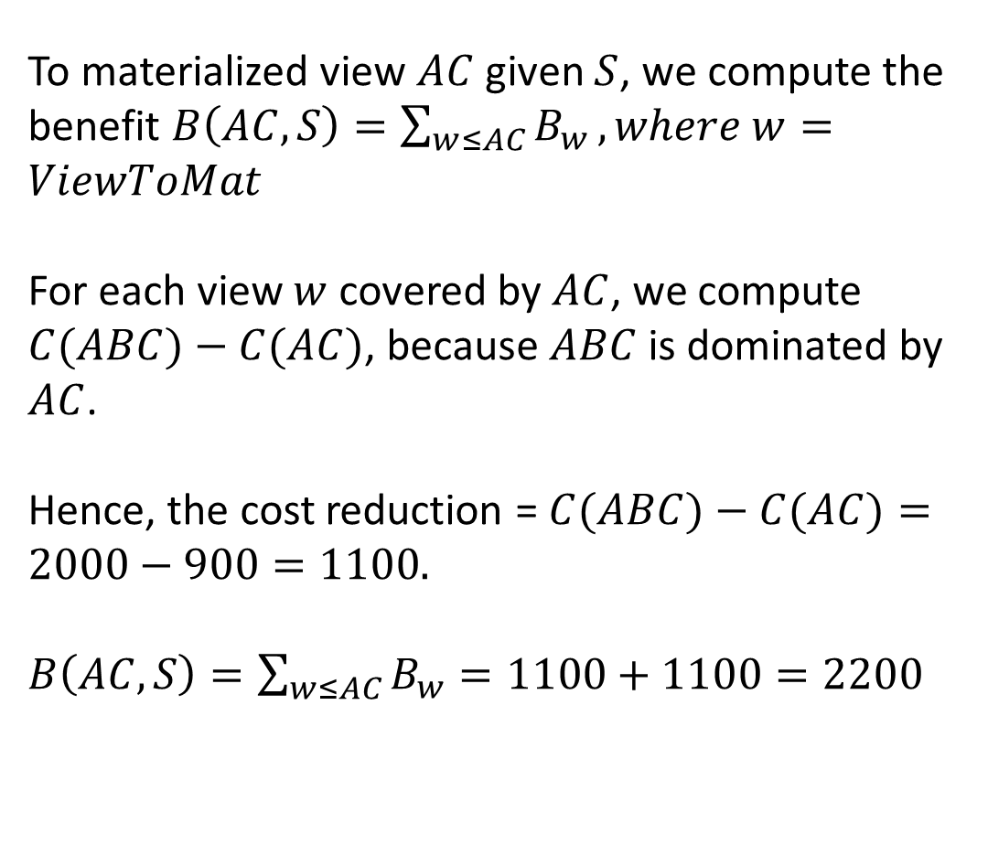
S = { | ABC, | AB | }
ViewToMat = w { | AB, | AC, | BC, | A, | B, | C, | All | }
CostReduction = | 6400 | - | - | - | - | - | -
To materialized view $AC$ given $S$, we compute the benefit $B\left(AC,S\right)=\sum_{w≤AC}{B_{w}}, where w=ViewToMat$
For each view $w$ covered by $AC$, we compute $C(ABC)−C(AC)$, because $ABC$ is dominated by $AC$.
Hence, the cost reduction = $C(ABC)−C(AC)=2000−900=1100.$
$B\left(AC,S\right)=\sum_{w≤AC}{B_{w}}=1100+1100=2200$

Slide 19
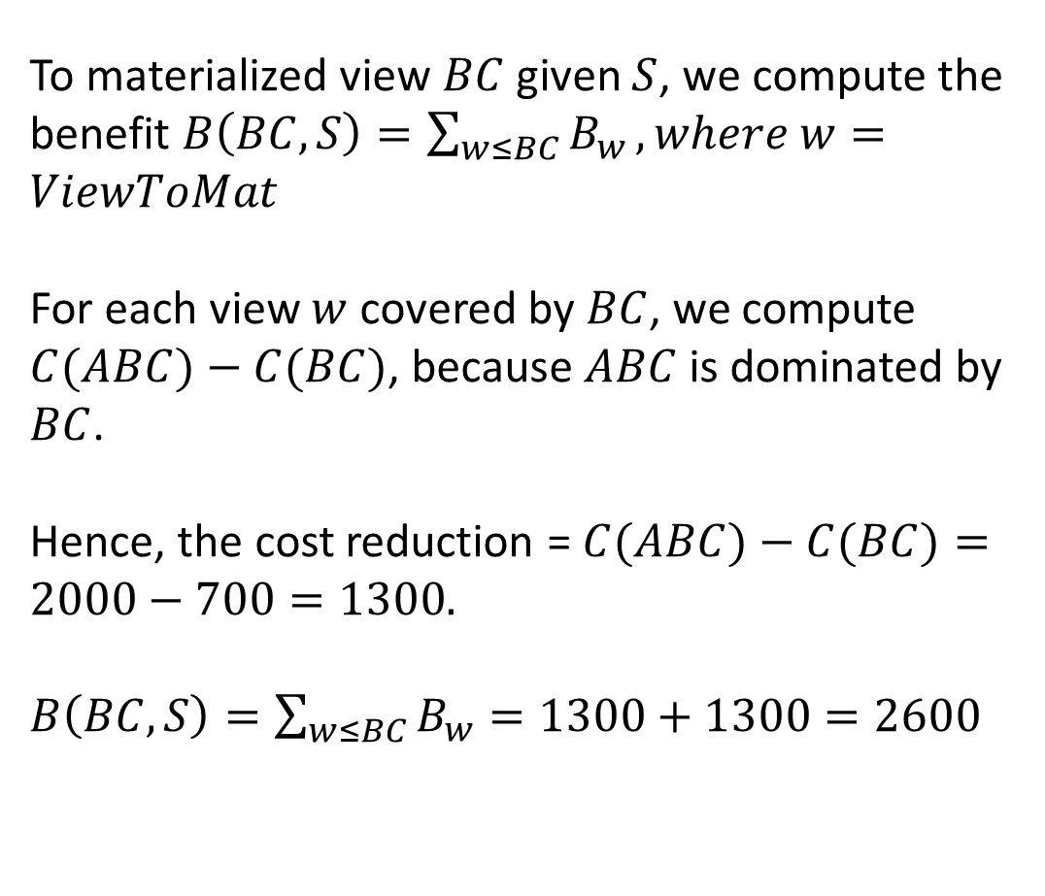
S = { | ABC, | AB | }
ViewToMat = w { | AB, | AC, | BC, | A, | B, | C, | All | }
CostReduction = | 6400 | 2200 | - | - | - | - | -
To materialized view $BC$ given $S$, we compute the benefit $B\left(BC,S\right)=\sum_{w≤BC}{B_{w}}, where w=ViewToMat$
For each view $w$ covered by $BC$, we compute $C(ABC)−C(BC)$, because $ABC$ is dominated by $BC$.
Hence, the cost reduction = $C(ABC)−C(BC)=2000−700=1300.$
$B\left(BC,S\right)=\sum_{w≤BC}{B_{w}}=1300+1300=2600$

Slide 20
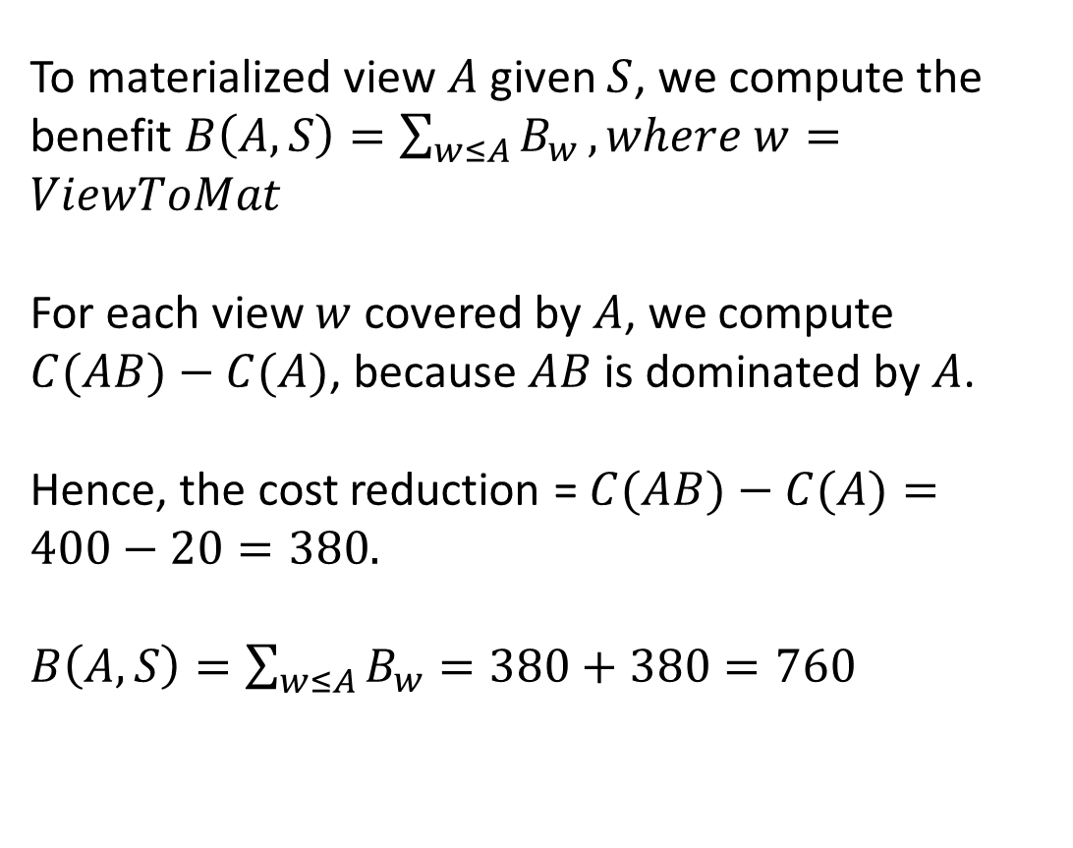
S = { | ABC, | AB | }
ViewToMat = w { | AB, | AC, | BC, | A, | B, | C, | All | }
CostReduction = | 6400 | 2200 | 2600 | - | - | - | -
To materialized view $A$ given $S$, we compute the benefit $B\left(A,S\right)=\sum_{w≤A}{B_{w}}, where w=ViewToMat$
For each view $w$ covered by $A$, we compute $C(AB)−C(A)$, because $AB$ is dominated by $A$.
Hence, the cost reduction = $C(AB)−C(A)=400−20=380.$
$B\left(A,S\right)=\sum_{w≤A}{B_{w}}=380+380=760$

Slide 21
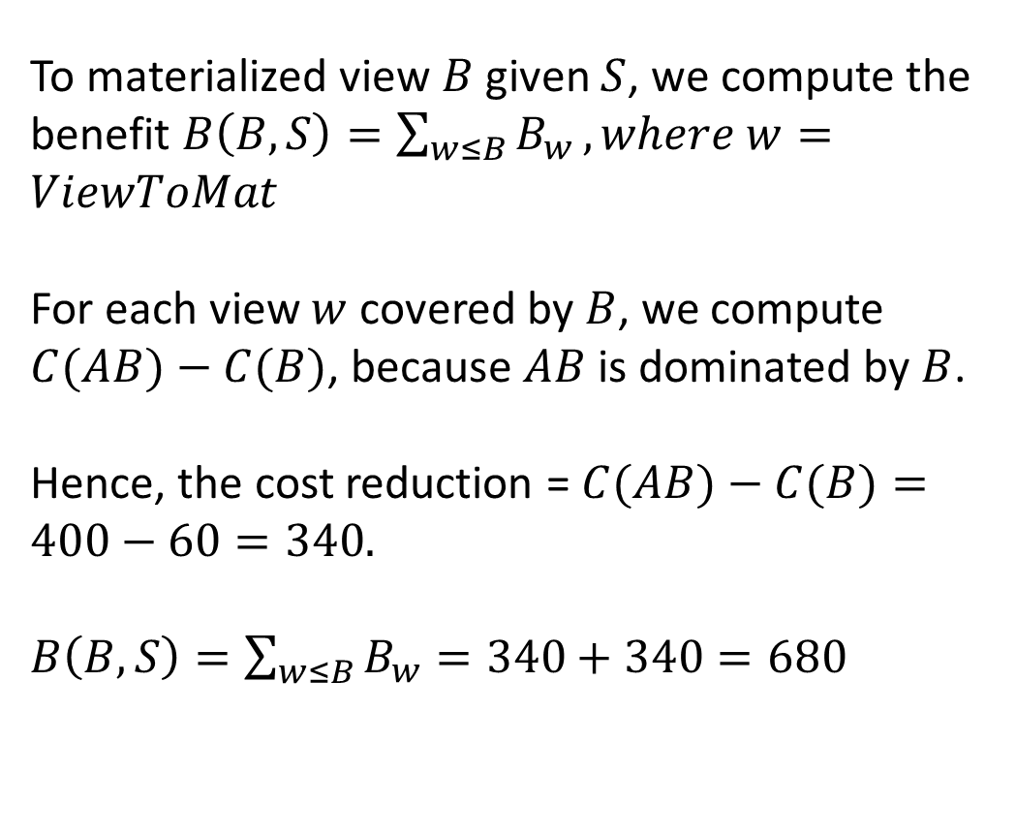
S = { | ABC, | AB | }
ViewToMat = w { | AB, | AC, | BC, | A, | B, | C, | All | }
CostReduction = | 6400 | 2200 | 2600 | 760 | - | - | -
To materialized view $B$ given $S$, we compute the benefit $B\left(B,S\right)=\sum_{w≤B}{B_{w}}, where w=ViewToMat$
For each view $w$ covered by $B$, we compute $C(AB)−C(B)$, because $AB$ is dominated by $B$.
Hence, the cost reduction = $C(AB)−C(B)=400−60=340.$
$B\left(B,S\right)=\sum_{w≤B}{B_{w}}=340+340=680$

Slide 22
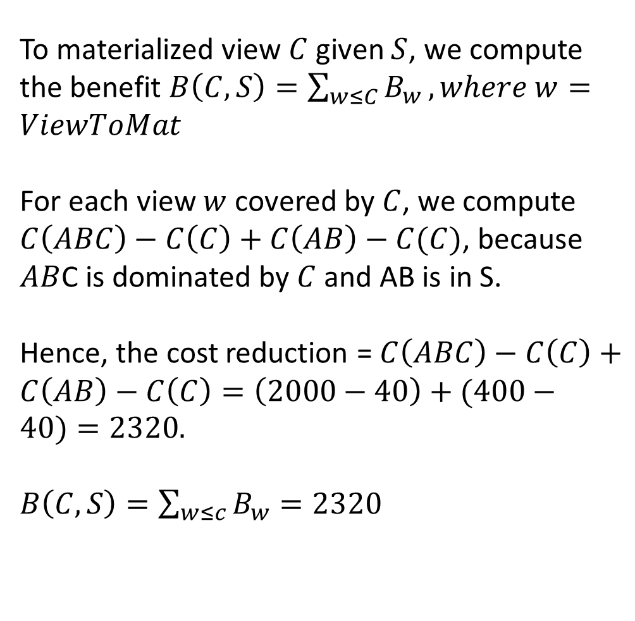
S = { | ABC, | AB | }
ViewToMat = w { | AB, | AC, | BC, | A, | B, | C, | All | }
CostReduction = | 6400 | 2200 | 2600 | 760 | 680 | - | -
To materialized view $C$ given $S$, we compute the benefit $B\left(C,S\right)=\sum_{w≤C}{B_{w}}, where w=ViewToMat$
For each view $w$ covered by $C$, we compute $C\left(ABC\right)−C\left(C\right)+C\left(AB\right)−C(C)$, because $AB$C is dominated by $C$ and AB is in S.
Hence, the cost reduction = $C\left(ABC\right)−C\left(C\right)+C\left(AB\right)−C\left(C\right)=\left(2000−40\right)+(400−40)=2320.$
$B\left(C,S\right)=\sum_{w≤c}{B_{w}}=2320$

Slide 23
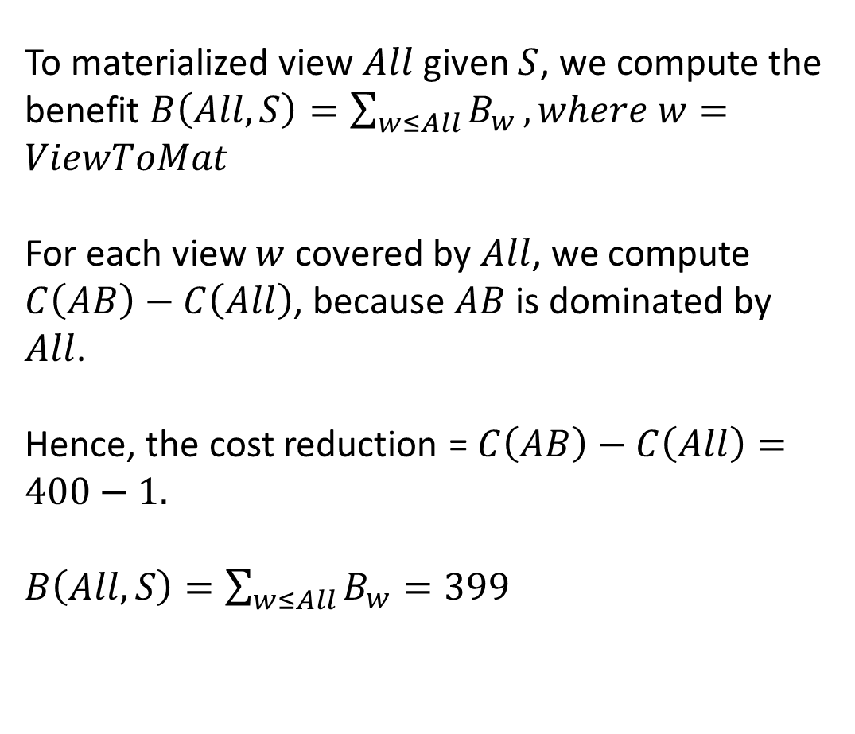
S = { | ABC, | AB | }
ViewToMat = w { | AB, | AC, | BC, | A, | B, | C, | All | }
CostReduction = | 6400 | 2200 | 2600 | 760 | 680 | 2320 | -
To materialized view $All$ given $S$, we compute the benefit $B\left(All,S\right)=\sum_{w≤All}{B_{w}}, where w=ViewToMat$
For each view $w$ covered by $All$, we compute $C\left(AB\right)−C\left(All\right)$, because $AB$ is dominated by $All$.
Hence, the cost reduction = $C\left(AB\right)−C\left(All\right)=400−1.$
$B\left(All,S\right)=\sum_{w≤All}{B_{w}}=399$

Slide 24
S = { | ABC, | AB | }
ViewToMat = w { | AB, | AC, | BC, | A, | B, | C, | All | }
CostReduction = | 6400 | 2200 | 2600 | 760 | 680 | 2320 | 399
The highest cost reduction from this iteration, 2600; that is by realizing the view BC. Hence, view BC will be materialized.

Slide 25
Third iteration

Slide 26
S = { | ABC, | AB, | BC | }
ViewToMat = w { | AB, | AC, | BC, | A, | B, | C, | All | }
CostReduction = | 6400 | 1100 | 2600 | 760 | 680 | 1020 | 399
Following the same process, the cost reduction for views AC, A, B, C and All are computed to be 1100, 700, 680, 1020 and 399 respectively.
The highest cost reduction in this iteration is 1100 by realizing the view AC.
Since we only need to realized 3 additional views, the final materialized views created will be AB, AC and BC.

